Slide 1
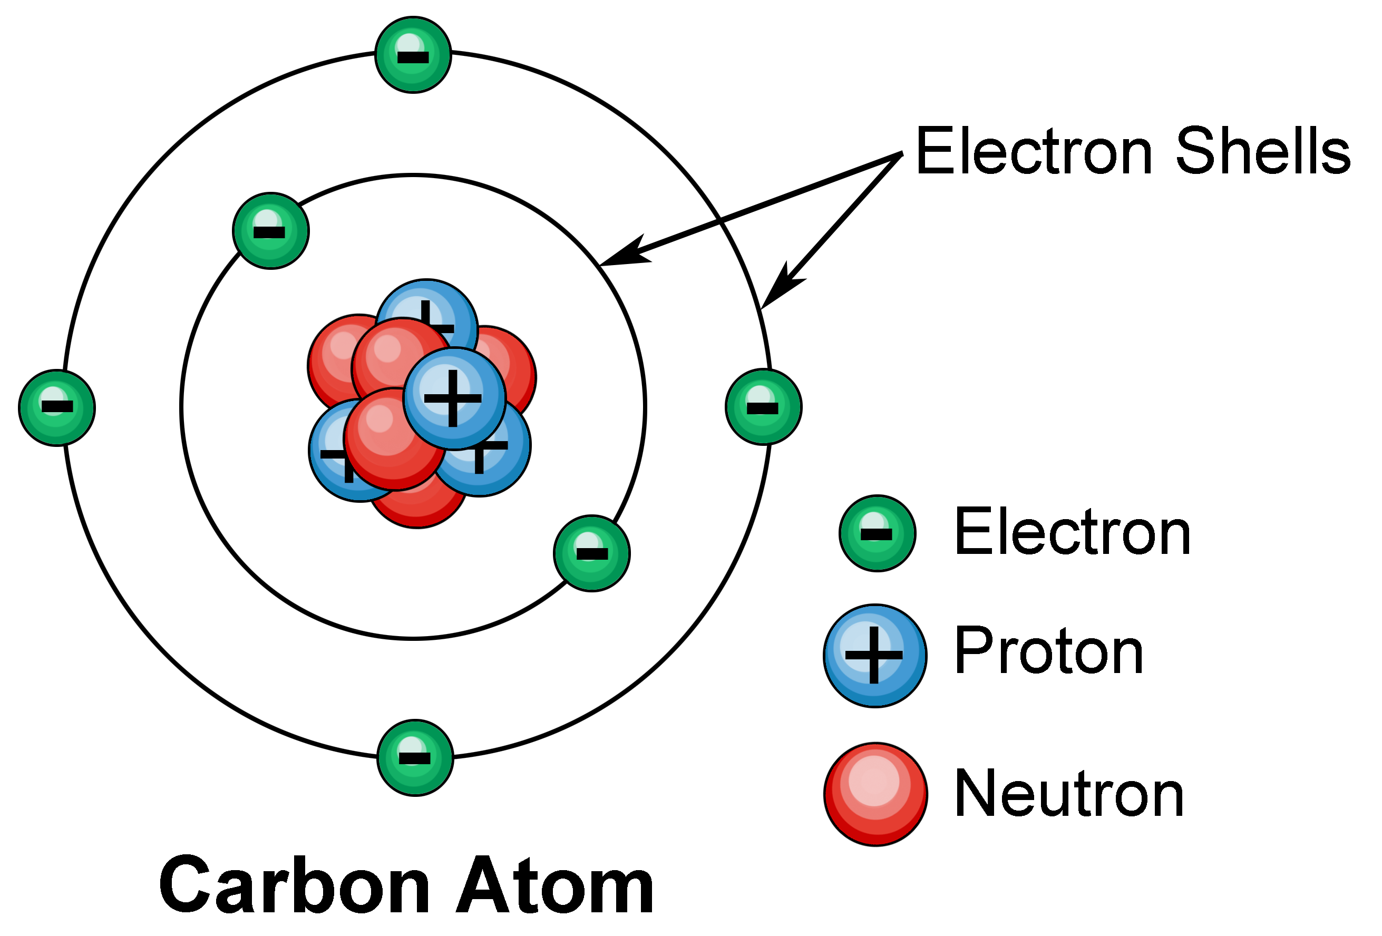
The Atom
Description, representation, Isotopes and ions
ATAR Chemistry Unit 1, 2021

Slide 2

Outline
Review – history of Atomic structure
The Atom
The Nucleus
The Electron cloud
Atomic number and Mass number
Isotopes
Ions

Slide 3
Review
Atomic structure : History Review
Recall the contributions of Scientists and their experiments changed the model we use to describe matter as atoms.
These Scientists include:
Dalton – Billiard Ball Model
JJ Thomson – Plum Pudding Model
Rutherford – Nuclear Model
Bohr – Nuclear model with electron shells
Chadwick – Completes nuclear model with neutrons in nucleus

Slide 4
The atom
All substances consist of atoms bound together in different ways.
The main features of the Structure of an atom are:
an atom consists of a cloud of negatively charges electrons surrounding a tiny, positively charged nucleus.
the electron cloud occupies most of the volume of the atom.
the nucleus consists of protons and neutrons.
The relative properties of the sub-atomic particles are:
Subatomic Particle | Symbol | Mass (kg) | Relative mass | Charge (C) | Relative charge
Proton | p | 1.673 x 10⁻²⁷ | 1 | 1.60 x 10⁻¹⁹ | + 1
Neutron | n | 1.675 x 10⁻²⁷ | 1 | 0 | 0
Electron | e | 9.110 x 10⁻³¹ | 1/1836 | -1.60 x 10⁻¹⁹ | - 1

Slide 5
Details on the Nucleus
According to atomic theory, atom is visualised as two main regions, the nucleus and the electron cloud.
Nucleus – central part of the atom & is composed of protons and neutrons (nucleons) held together by the strong nuclear force.
Has a positive charge equal to the number of protons
Is extremely small compared to the whole atom
Diameter of atom is 100 000 times larger than diameter of nucleus
Contains over 99.9% of the mass
Is very dense (large mass – small volume)

Slide 6
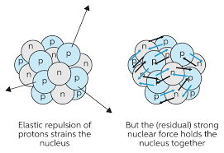
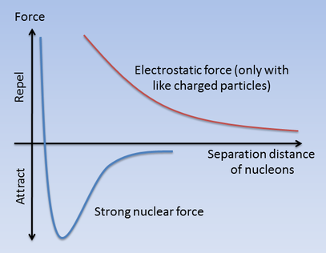
What holds the Nucleus together?
The nucleus is extremely compact and seems to defy logic squashing together positive protons that would repel each other.
While the Electrostatic Force between the like charged protons is trying to push them apart, another force is also acting.
The Strong Nuclear Force attracts nucleons together regardless of charge, however, is only works on a short range.
The stability of the nucleus depends on the balance between these two forces.

Slide 7
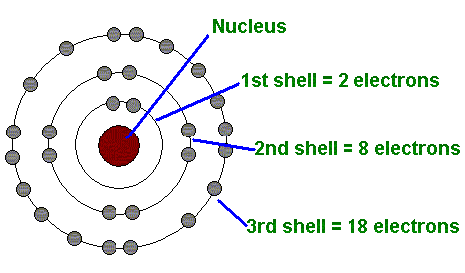
Details on the Electron Cloud
Electrons – move in relatively large space, called electron cloud outside the nucleus
Being negatively charged, electrons are kept moving around nucleus by electrostatic forces between them & positively charged nucleus
The Bohr model of the atom puts electrons in shells of different energy. Each shell can only accommodate a fixed number of electrons.

Slide 8
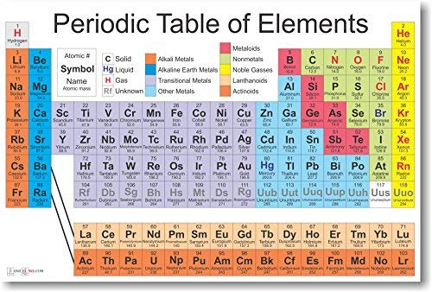
Different types of atoms
Atom’s identity is determined by number of protons in its nucleus
This is given a special name – Atomic Number and has the symbol Z
eg 1 proton = hydrogen 6 protons = carbon
In electrically neutral atom the number of protons equals the number of electrons
The Periodic table sorts elements by their Atomic Number

Slide 9
Mass Number (A)
As the majority of the mass on an atom is contained the nucleus, scientists describe the mass of atoms using the mass number (A)
The mass number is equal to the number of nucleons in the nucleus, that is the number of protons plus neutrons.
For lighter atoms, the numbers of protons and number of neutrons are approximately equal.
Heavier atoms have more neutrons than protons e.g. Uranium 92 p & 143 n
Mass Number = Number of protons + Number of neutrons
# n = A - Z

Slide 10
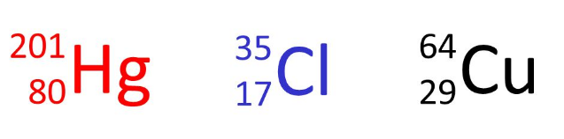
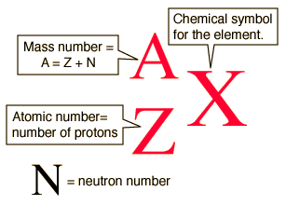
Periodic table representation convention
How many proton, neutrons and electrons do each of these contain?

Slide 11
Isotopes
All atoms of the same type, of the same element, have the same number of protons in the nucleus (Z determines the element!)
However, not all atoms of an element have the same number of neutrons.
E.g. oxygen (O) in air:
over 99% have 8 neutrons
0.2% have 10 neutrons
0.04% have 9 neutrons
¹⁶₈O ¹⁷₈O ¹⁸₈O

Slide 12
Examples of Isotopes
Type of isotope | Name | Symbol | Protons | Neutrons | electrons
Isotopes Of hydrogen | hydrogen | ¹₁H | 1 | 0 | 1
 | Deuterium | ²₁H | 1 | 1 | 1
 | Tritium | ³₁H | 1 | 2 | 1
Isotopes Of Carbon | Carbon-12 | ¹²₆C | 6 | 6 | 6
 | Carbon-13 | ¹³₆C | 6 | 7 | 6
 | Carbon-14 | ¹⁴₆C | 6 | 8 | 6
Note: The amount of each isotope found in nature (abundance) is not even for each isotope. It can vary significantly. The abundances are used to determine the relative atomic masses seen on the periodic table by averaging according to how much of each isotope is observed.

Slide 13
Ions
Atoms form ions by either gaining or losing electrons
The electron configuration of an atom and its ion(s) must be different
Oxygen (O) valency: 6
Oxide (O²⁻) valency: 8
the atom has gained two electrons giving it the same configuration as neon
Atoms readily gain or lose electron to give them an ion with a noble gas electron configuration (this is called the octet rule)
Noble gas electron configurations are uniquely stable

Slide 14
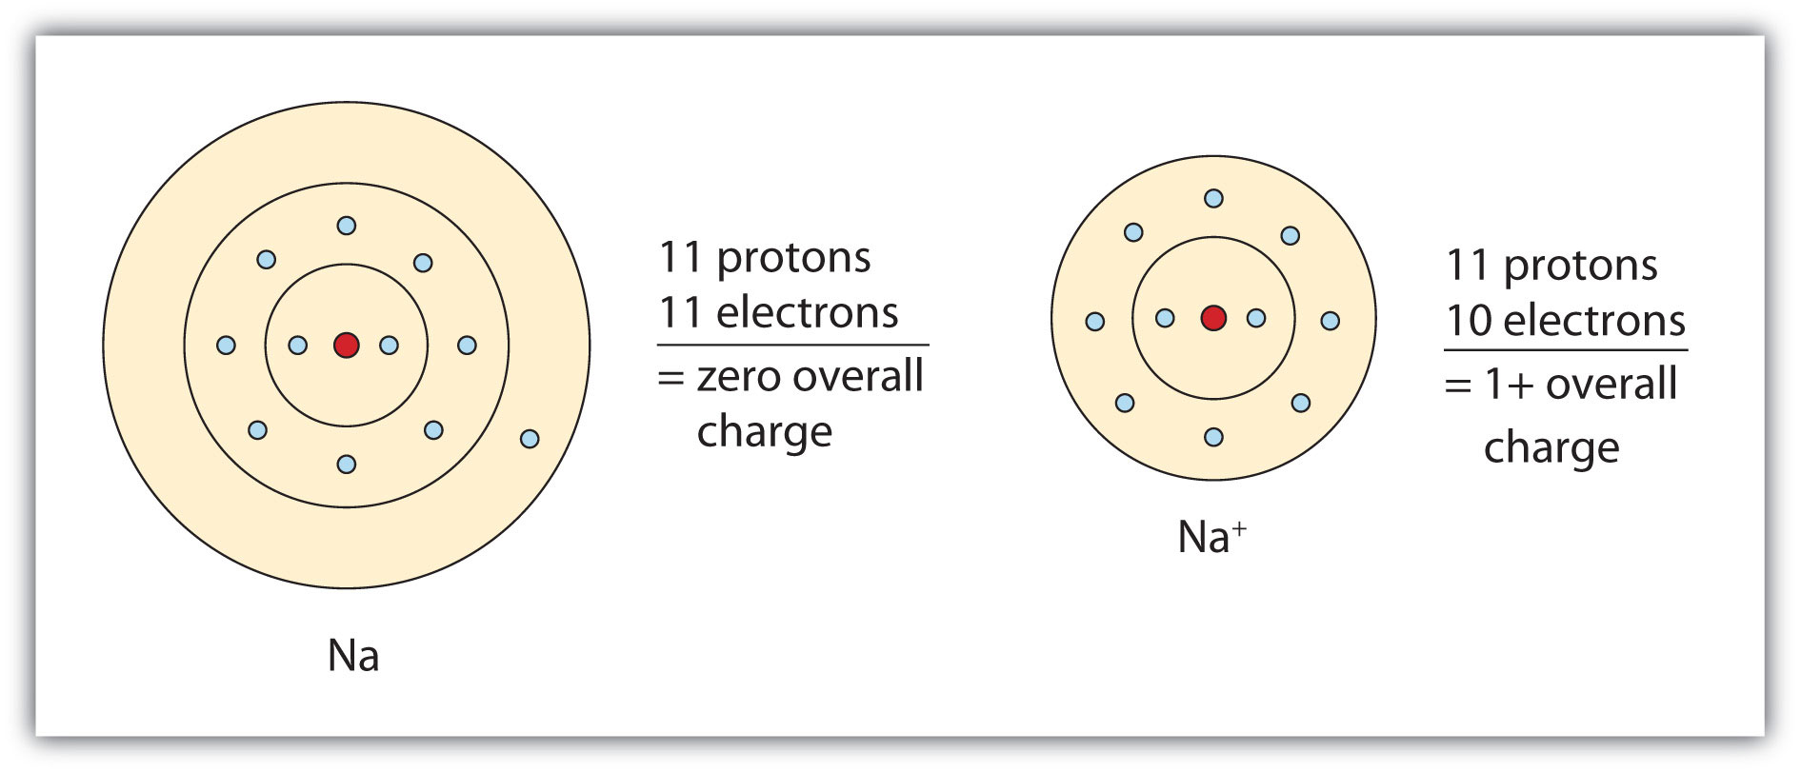
Examples of Ions
Type of ion | Name | Symbol | Protons | electrons
+1 ion | sodium | Na⁺ | 11 | 10
+ 2 ion | magnesium | Mg²⁺ | 12 | 10
-1 ion | chloride | Cl⁻ | 17 | 18
-2 ion | oxide | O²⁻ | 8 | 10

Slide 15
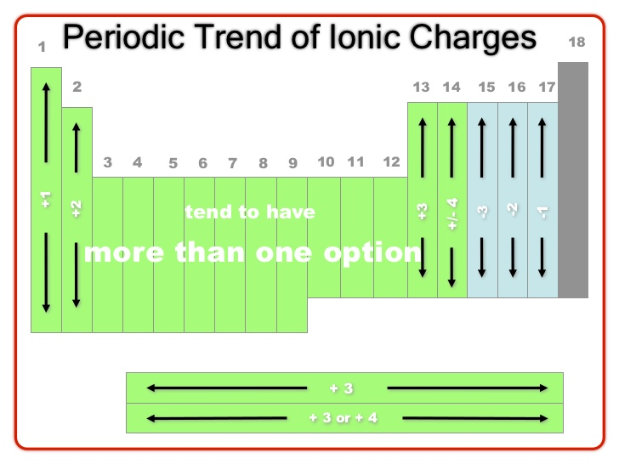
Ions and the Periodic table

Slide 16
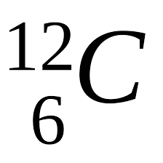
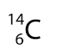
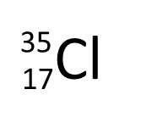
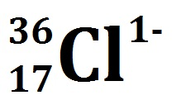
Element | Protons | Neutrons | Electrons | Example of an Isotope or Ion
Question

Slide 17
Element | Protons | Neutrons | Electrons | Example of an Isotope or Ion
 | 6 | 6 | 6 | isotope
 | 6 | 8 | 6 | isotope
 | 17 | 18 | 17 | Isotope
 | 17 | 19 | 18 | Isotope and ion
Question

Slide 18
On going work
Pearson Year 11 Chemistry - Read and complete Review Questions for:
Chap 2.1 Atomic Theory.
Chap 2.2 Describing atoms.
Chap 2.3 Isotopes.
STAWA Year 11 Exploring Chemistry - Read and complete questions for:
Set 8 – Atoms and Isotopes.

